Slide 1
ECE 884 Deep Learning
Lecture 11: Backpropagation
02/23/2021

Slide 2
Review of last lecture
(Deep) Neural Networks
Perceptron
Multilayer Perceptron (MLP)
Activation Functions
Why Neural Networks are powerful

Slide 3
Today’s lecture
Backward Propagation (Backpropagation)

Slide 4
Forward Propagation of Neural Networks
2-layer Neural Network
𝑓 𝑥
= 𝑊₂ g (𝑊 ₁ 𝑥 + 𝑏 ₁ ) + 𝑏 ₂
Input: 3072
x
W₁
h
W₂
s
Output: 10
Hidden layer: 100

Slide 5
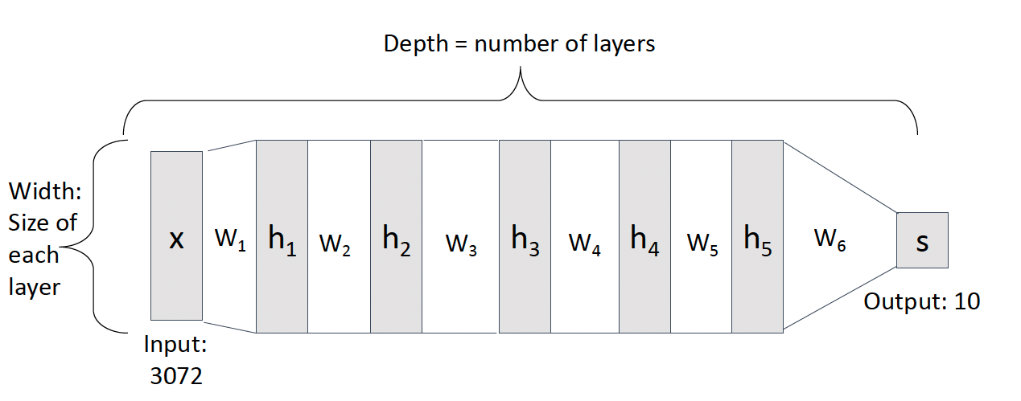
Forward Propagation of Neural Networks
Deep Neural Network

Slide 6
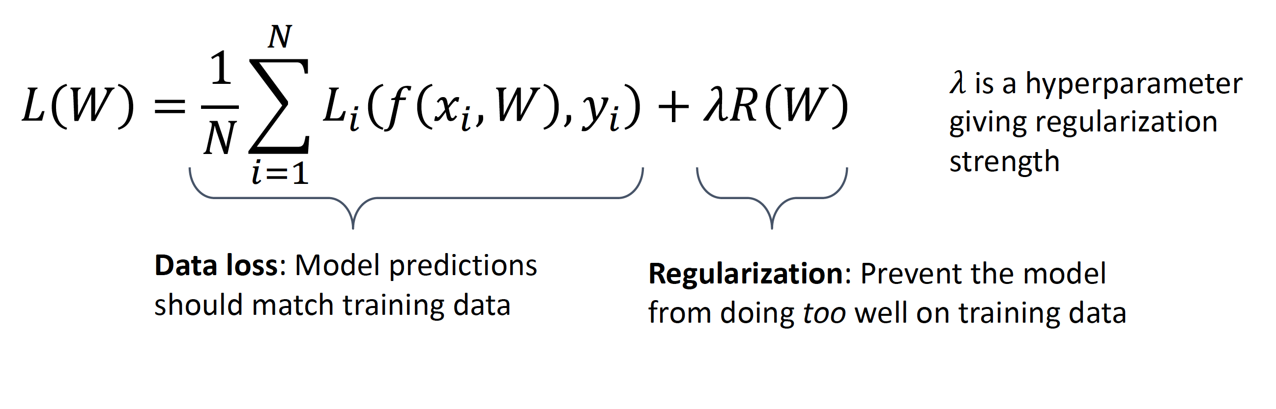
Loss Function

Slide 7
𝑤∗ = arg min 𝐿 𝑤
Training
w

Slide 8
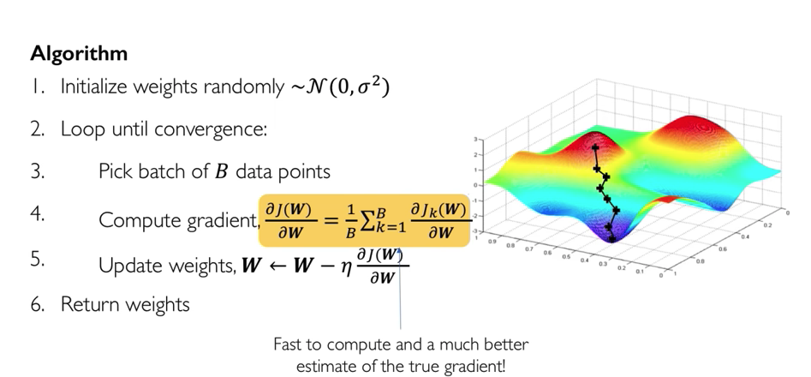
Stochastic Gradient Descent (SGD)
Approximate sum using a minibatch of 32 / 64 / 128 examples

Slide 9
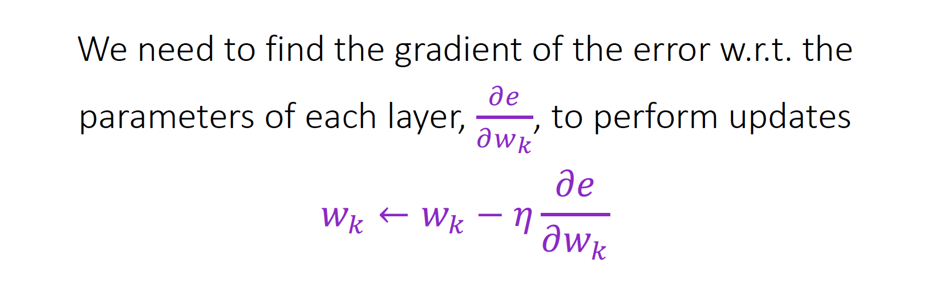
Backward Propagation
Backpropagation is the method to calculate the gradients for every single weight of the neural network via computational graph.

Slide 10
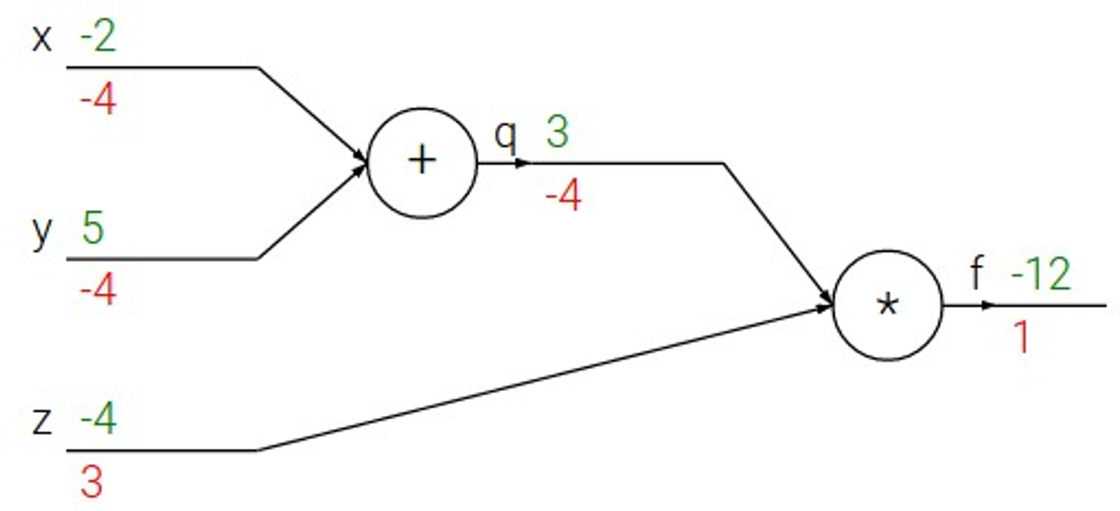
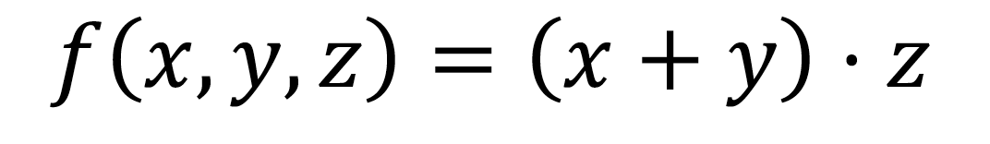
Backpropagation: Simple Example

Slide 11
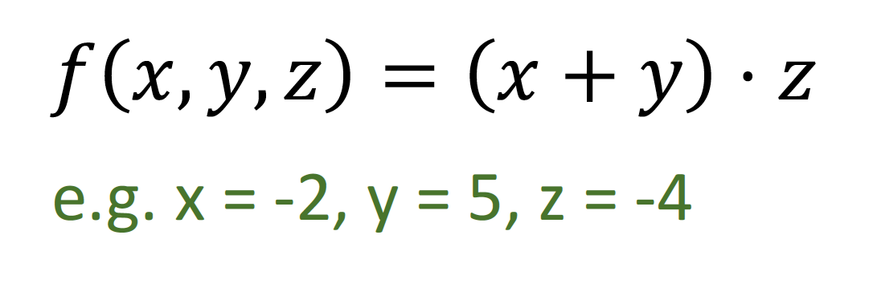
Backpropagation: Simple Example

Slide 12
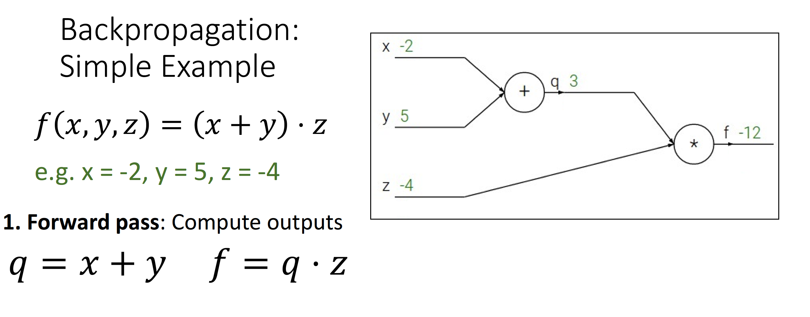

Slide 13
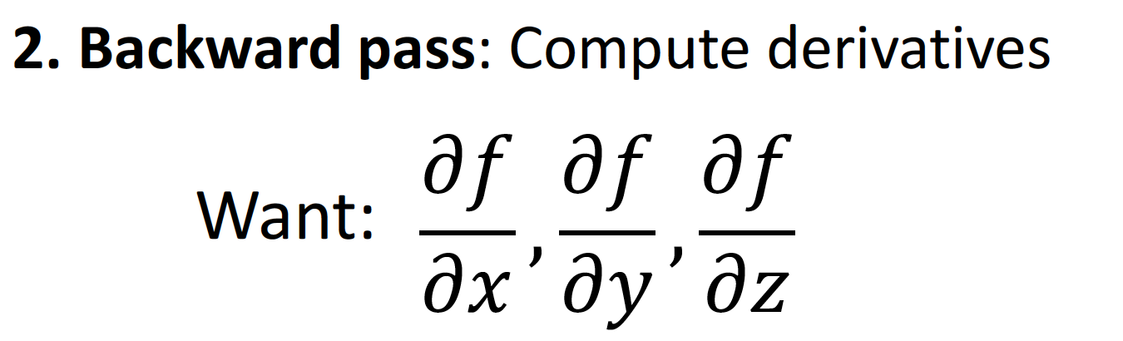

Slide 14
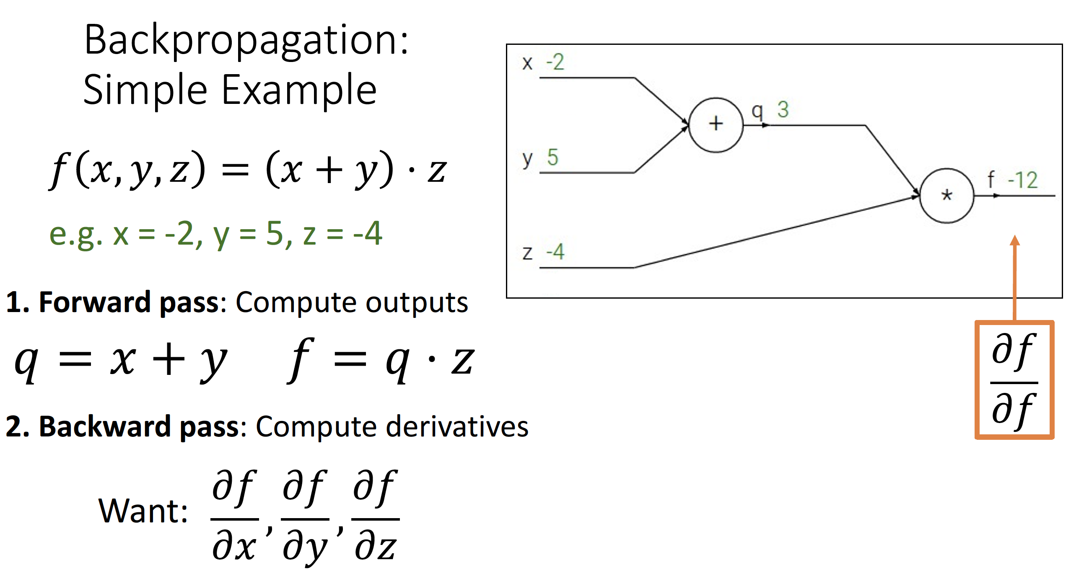

Slide 15
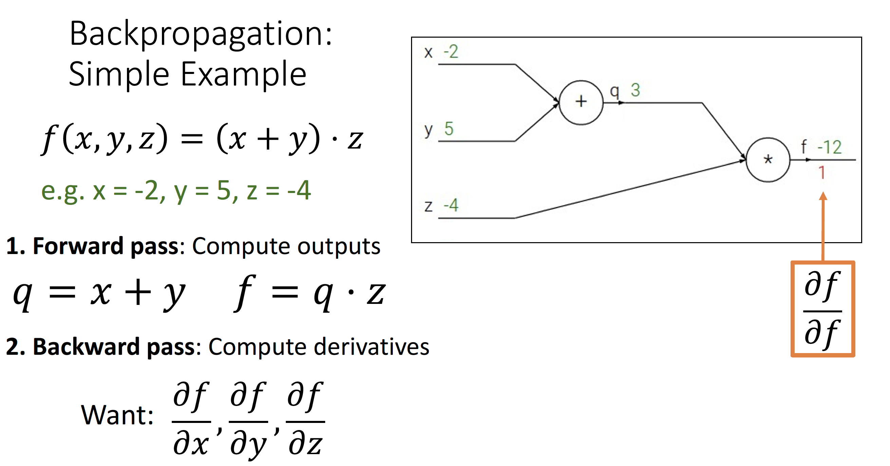

Slide 16
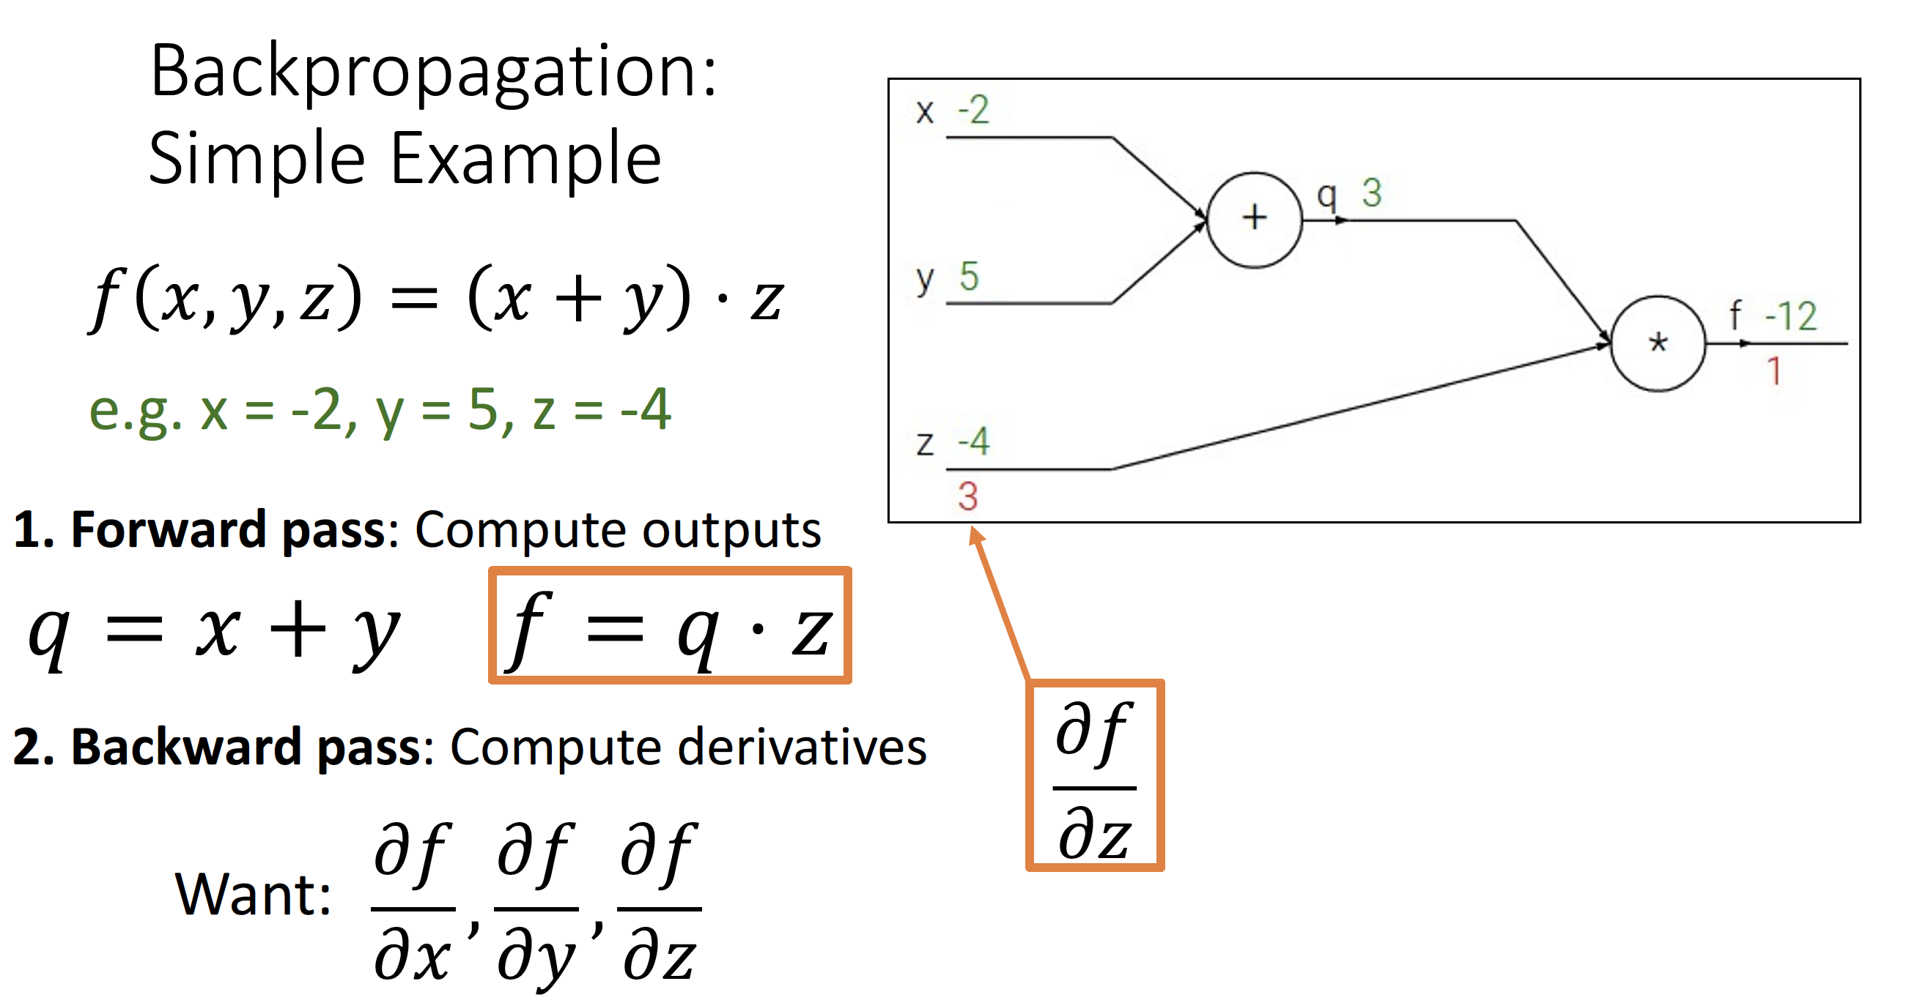

Slide 17
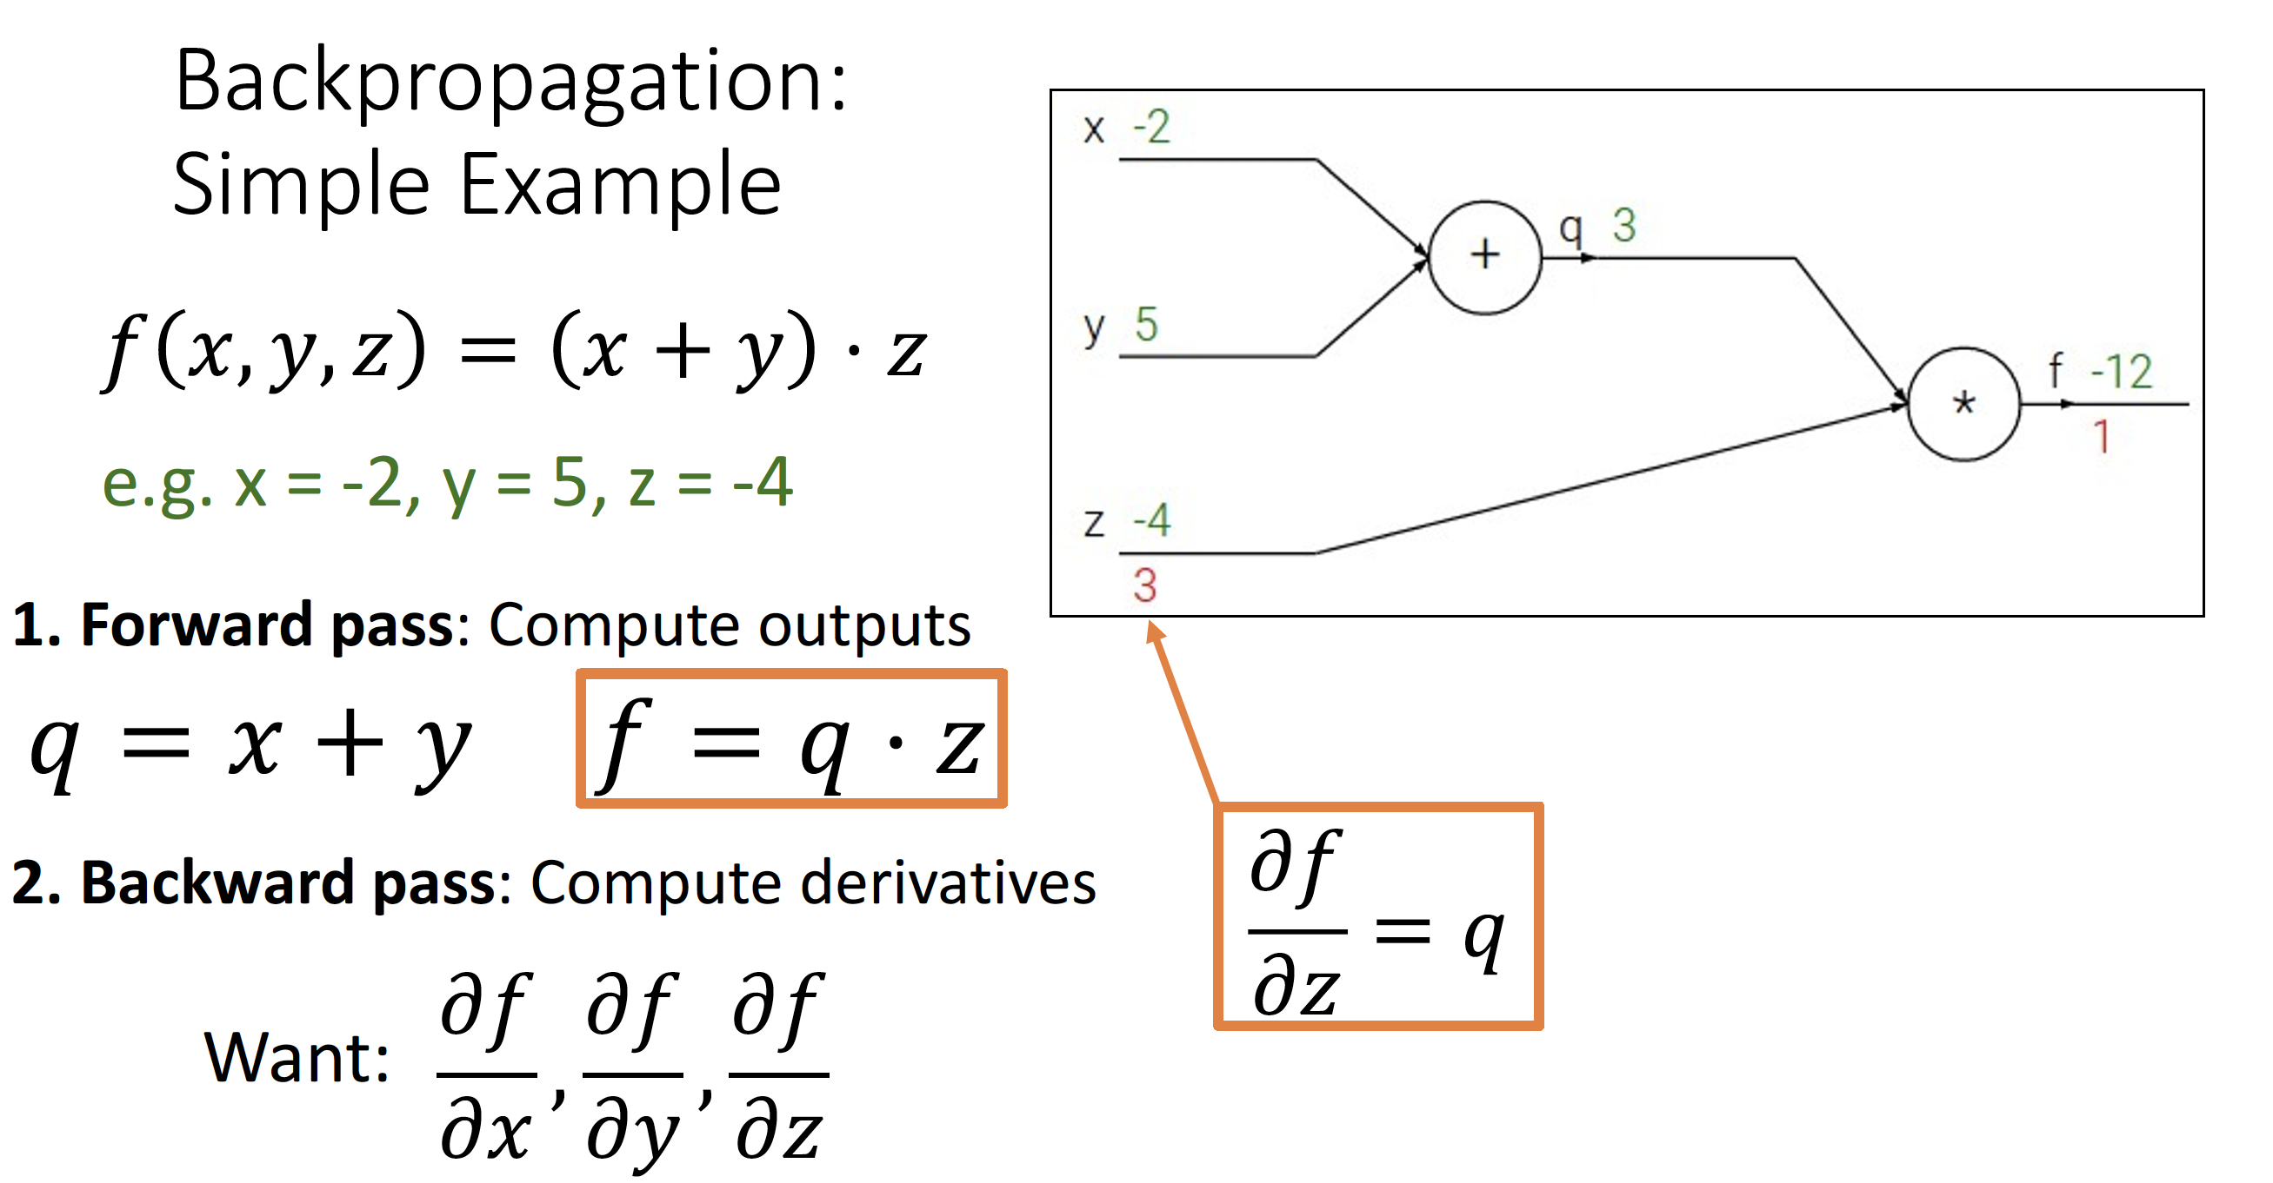

Slide 18
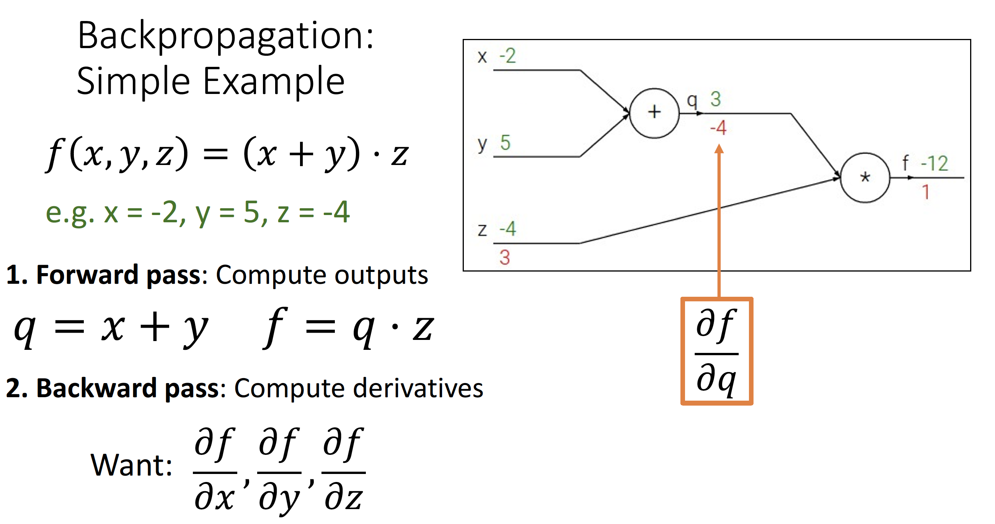

Slide 19
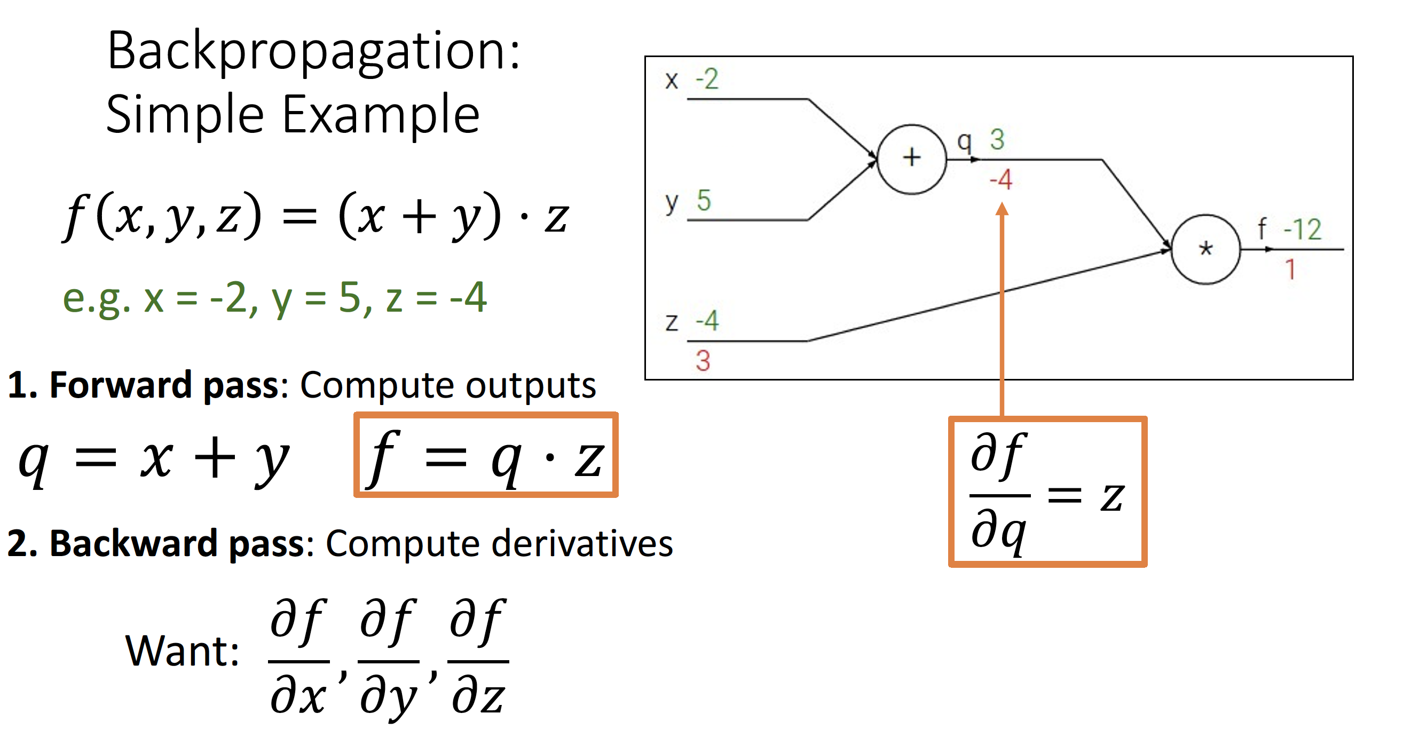

Slide 20
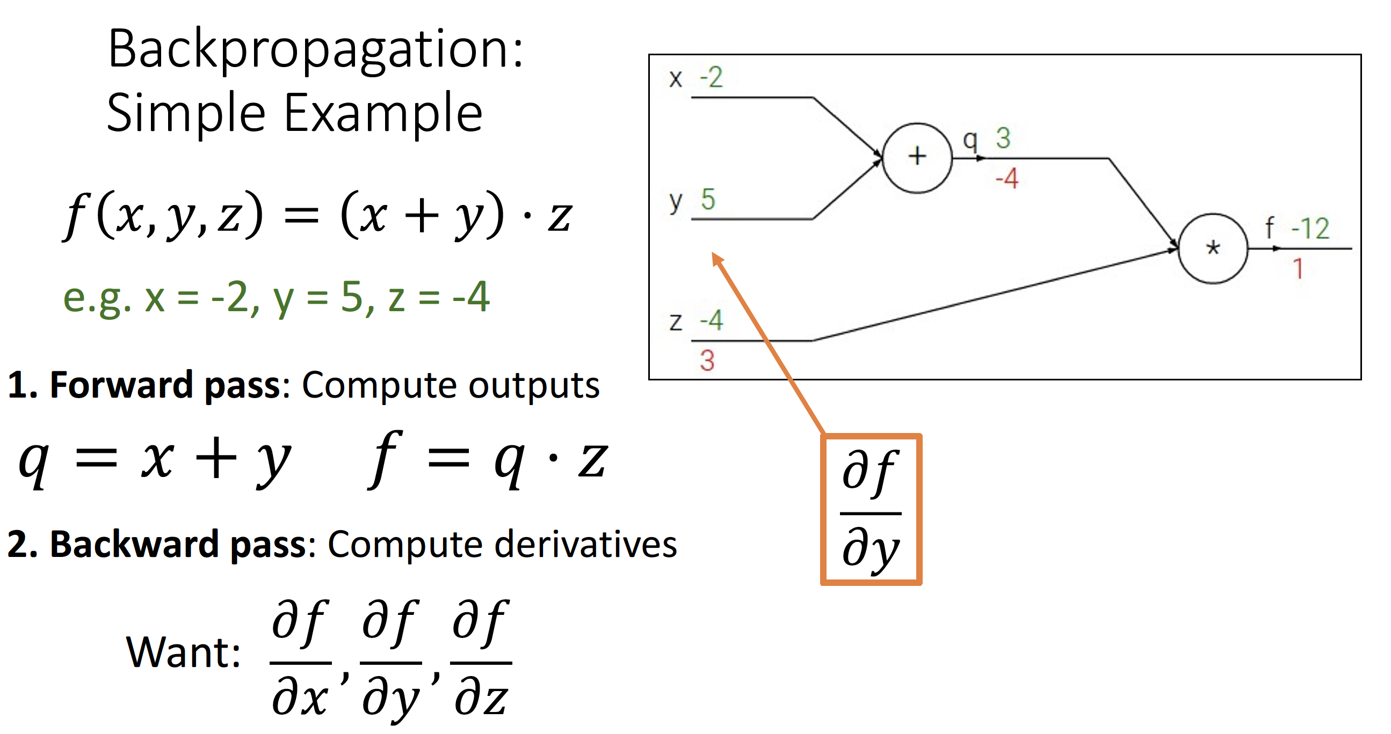

Slide 21
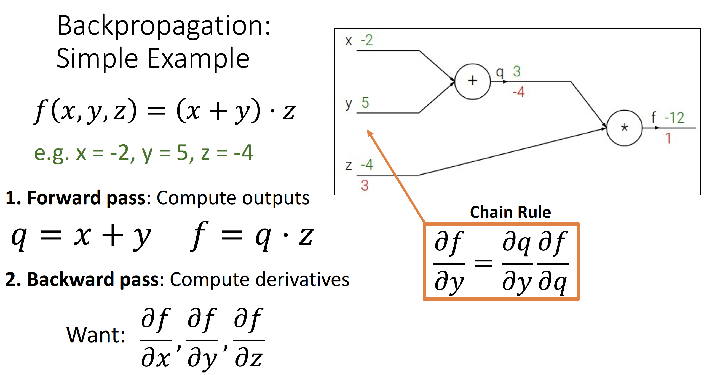

Slide 22
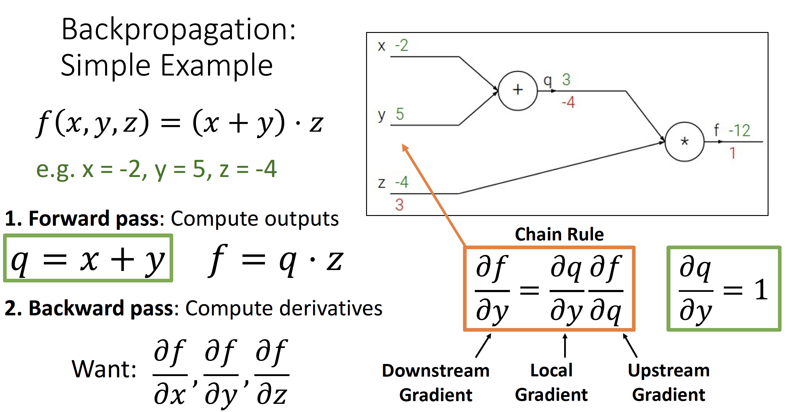

Slide 23
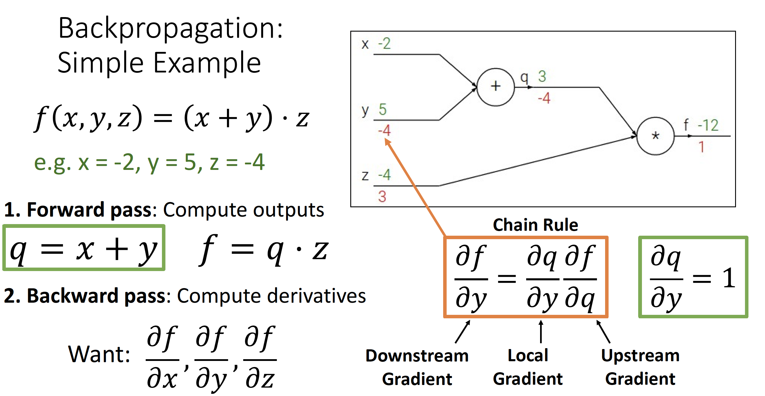

Slide 24
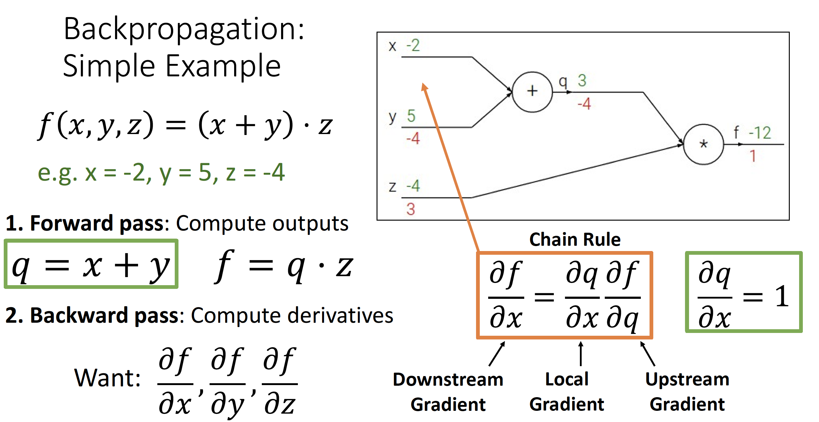

Slide 25
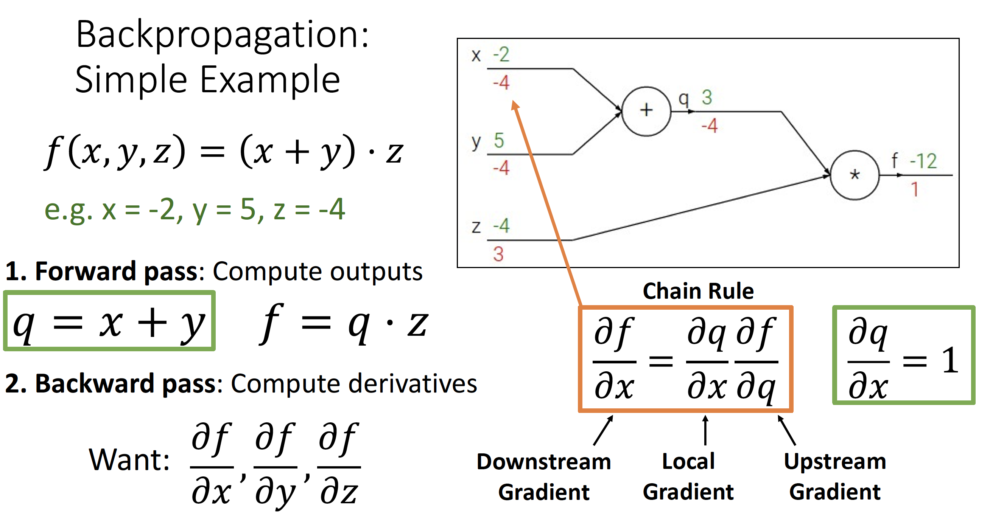

Slide 26
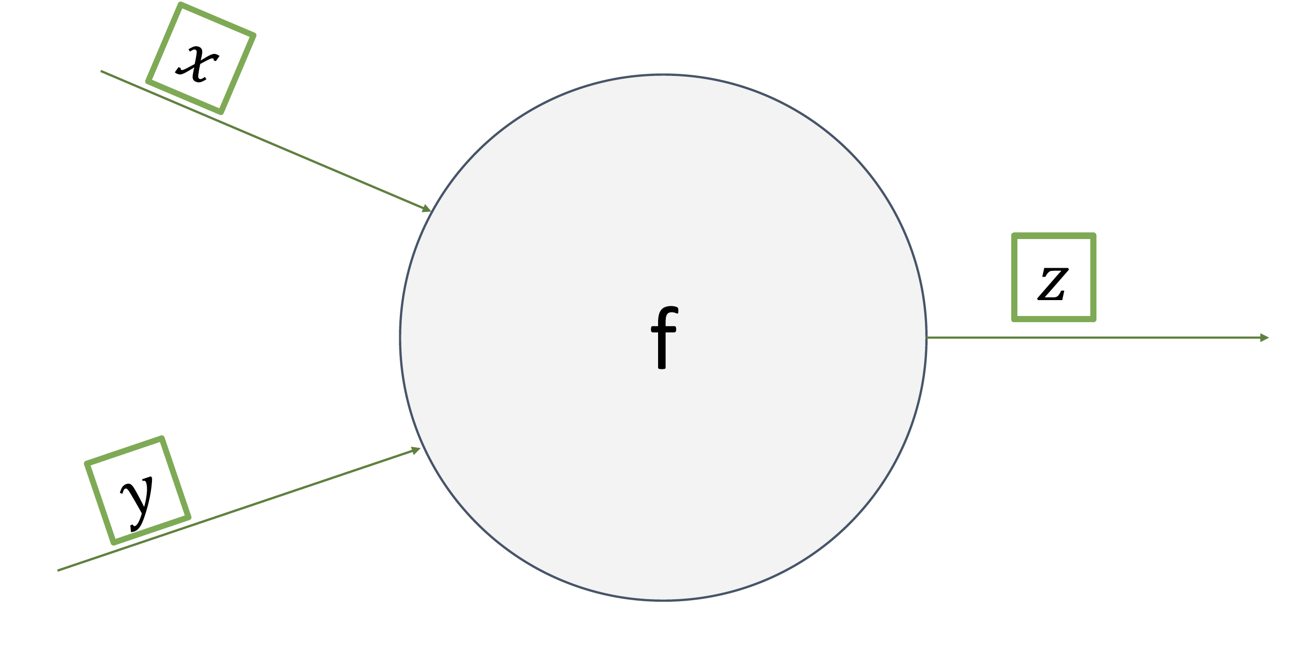

Slide 27
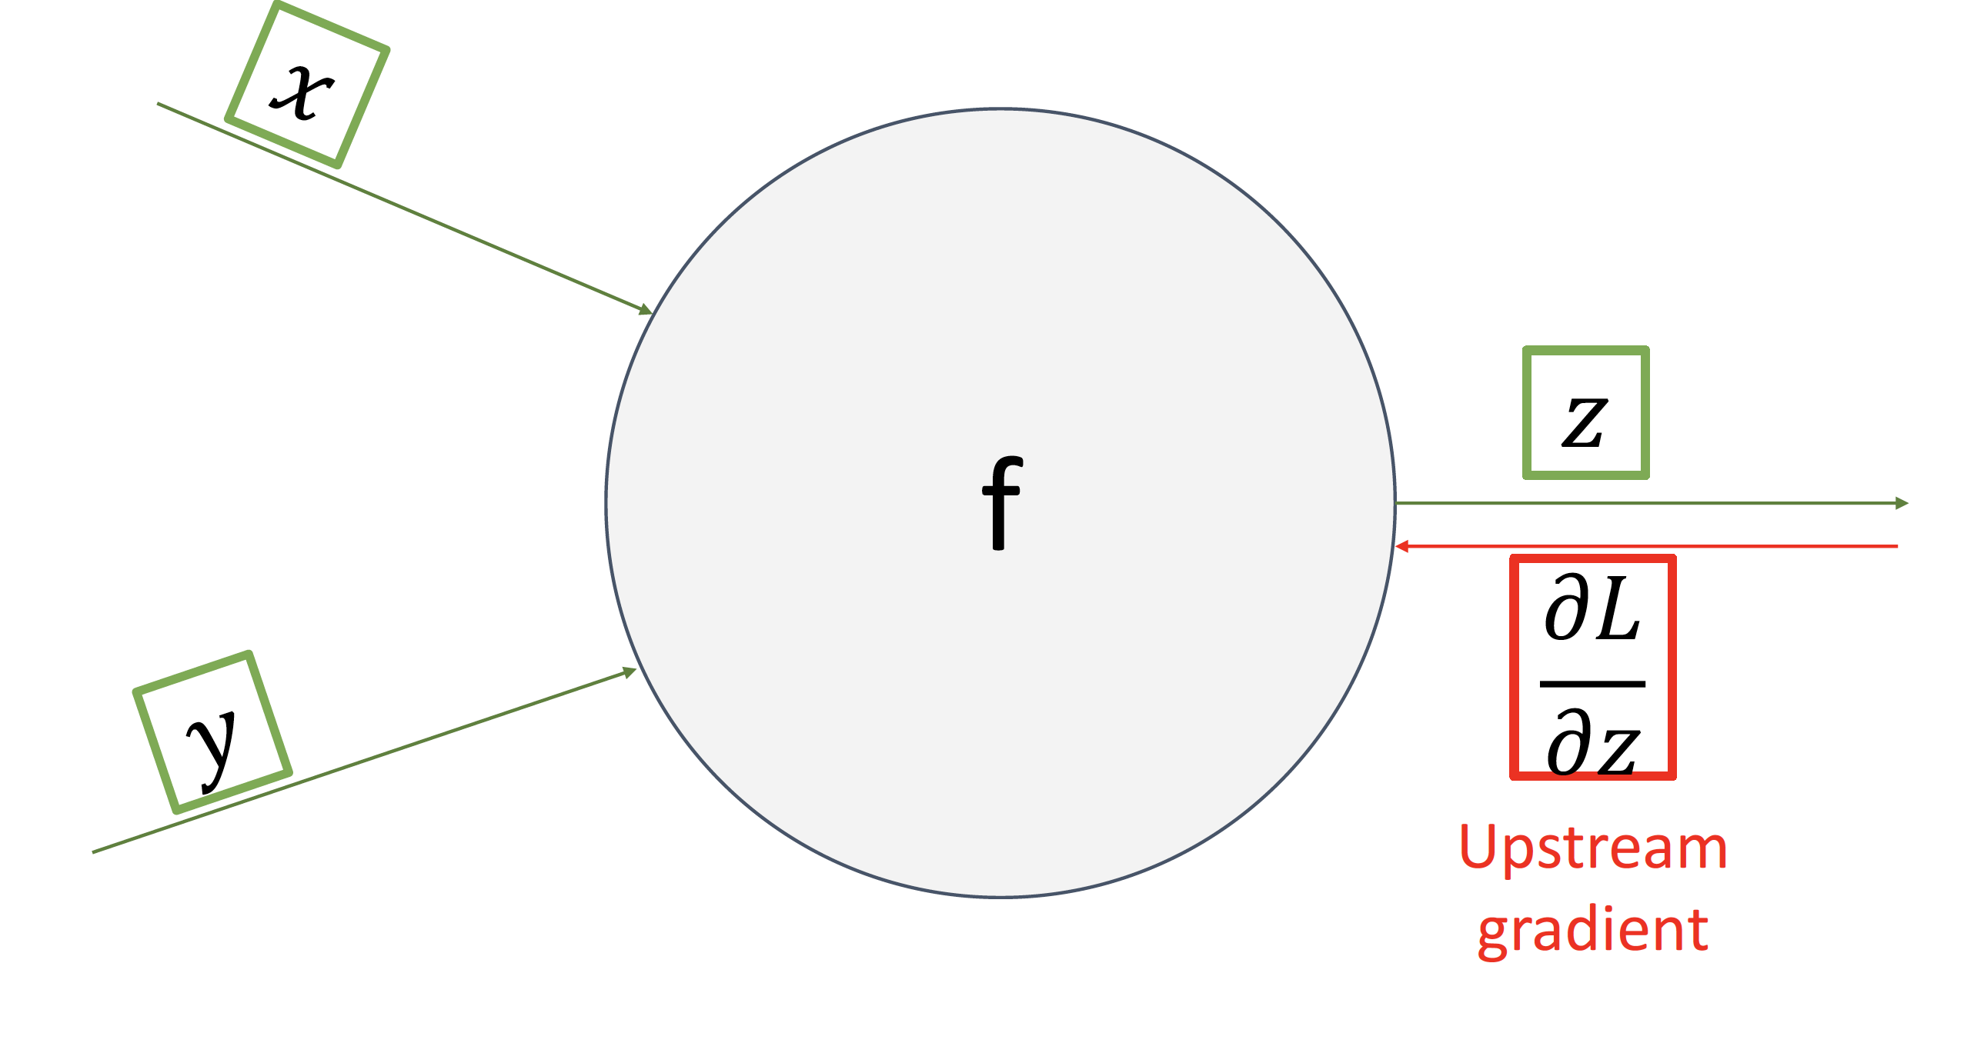

Slide 28
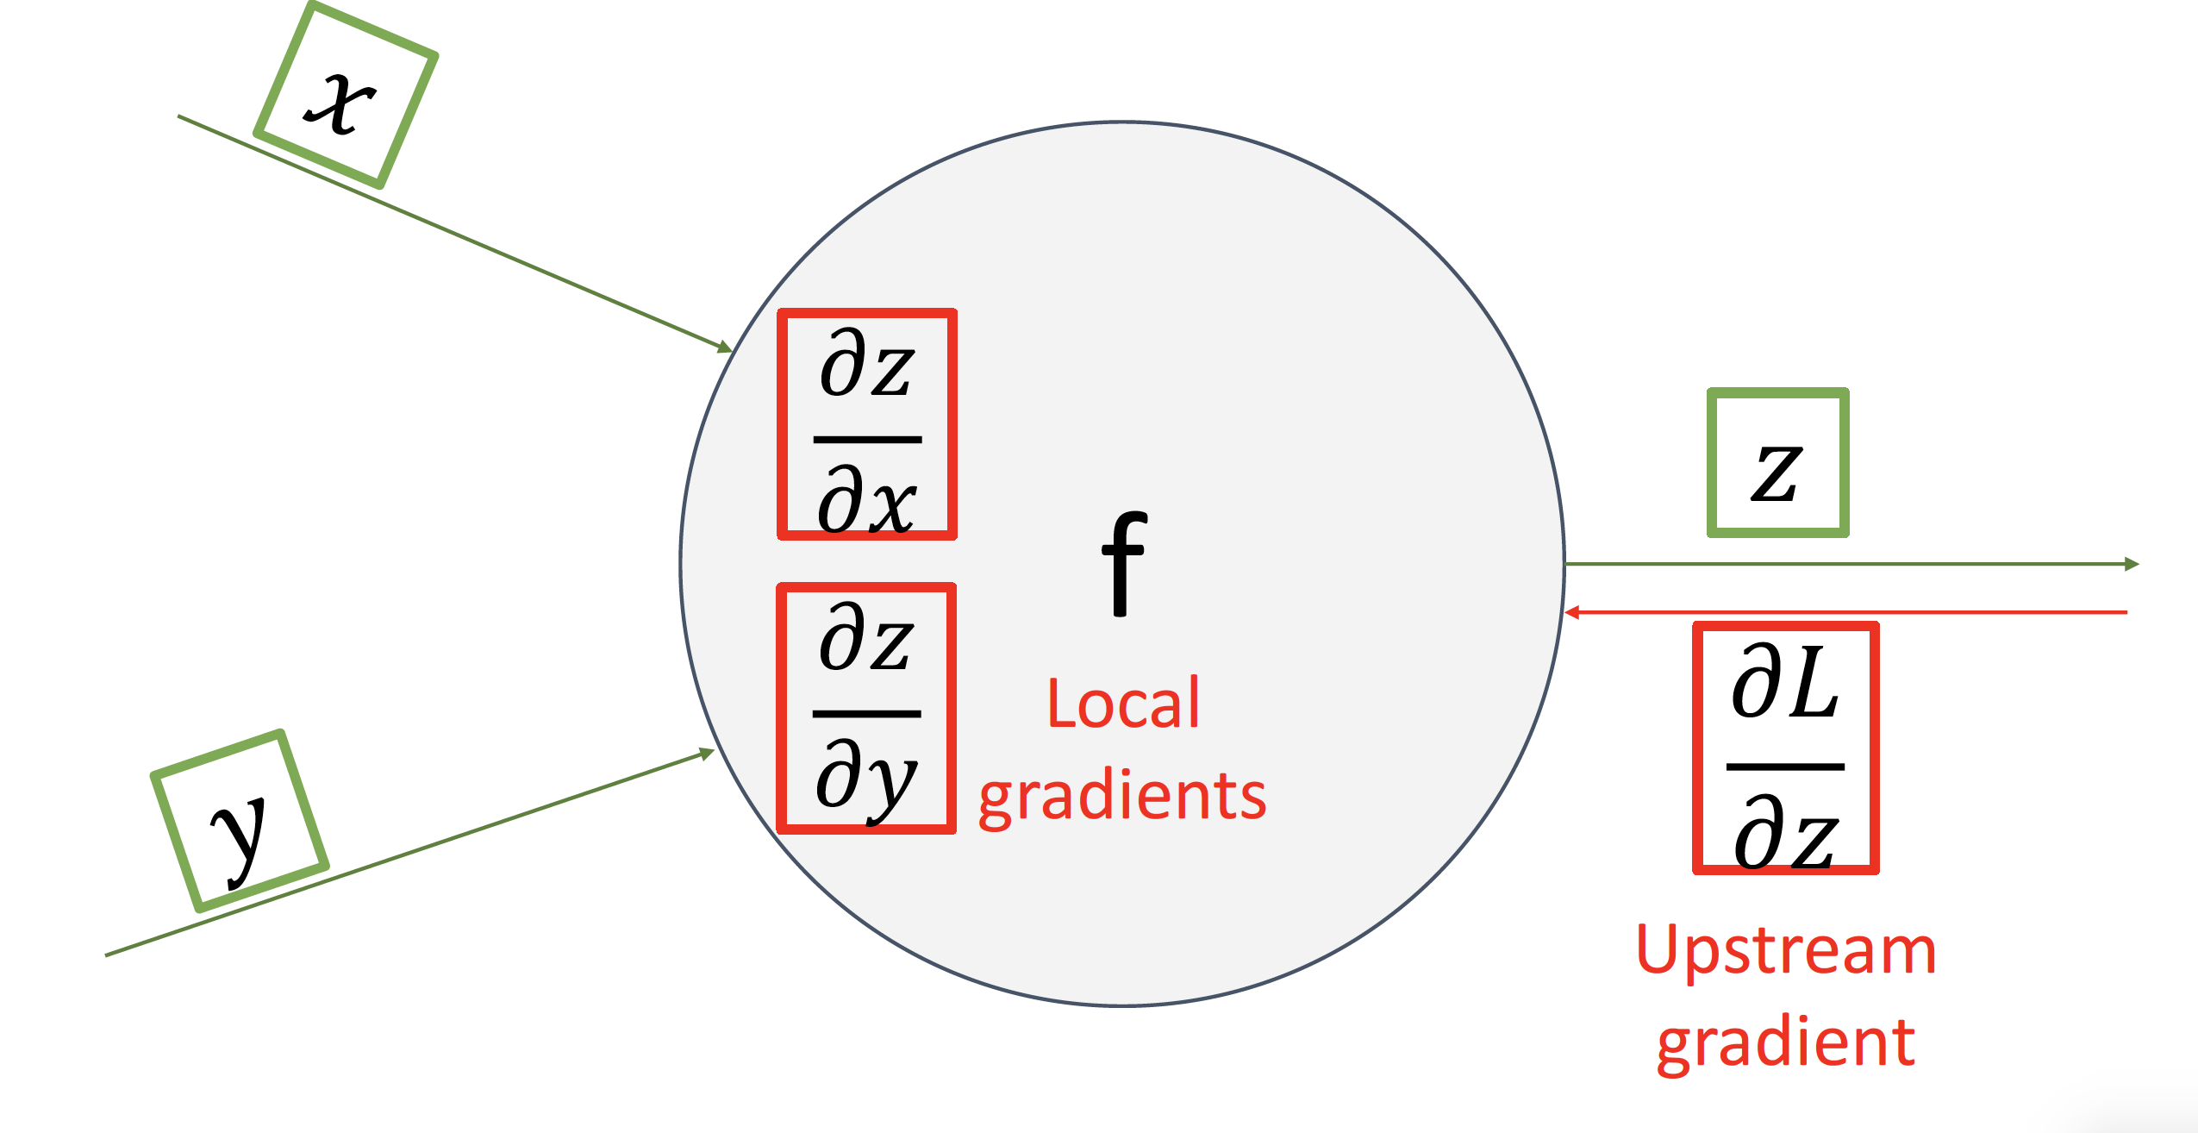

Slide 29
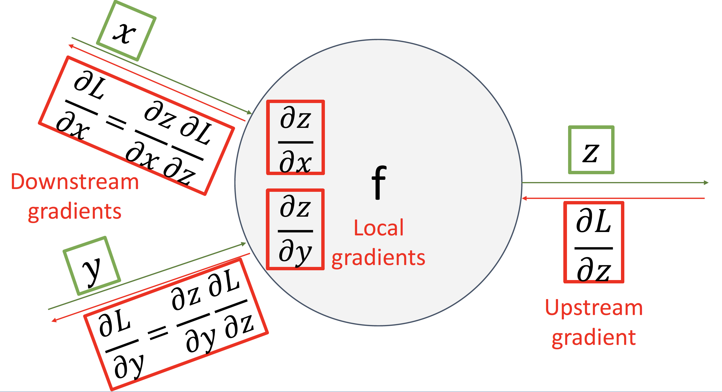

Slide 30
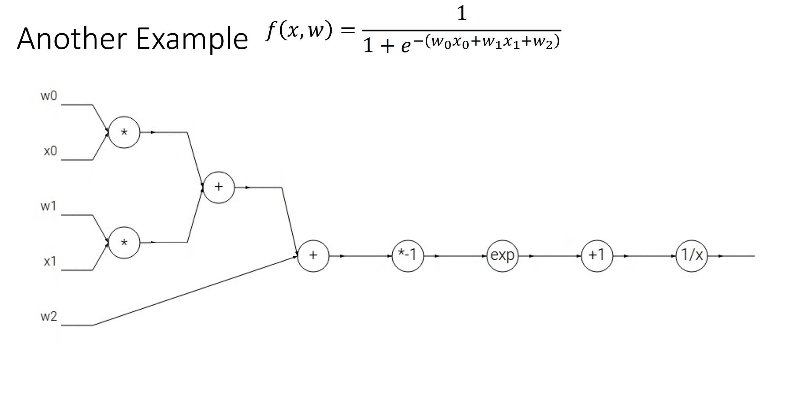

Slide 31
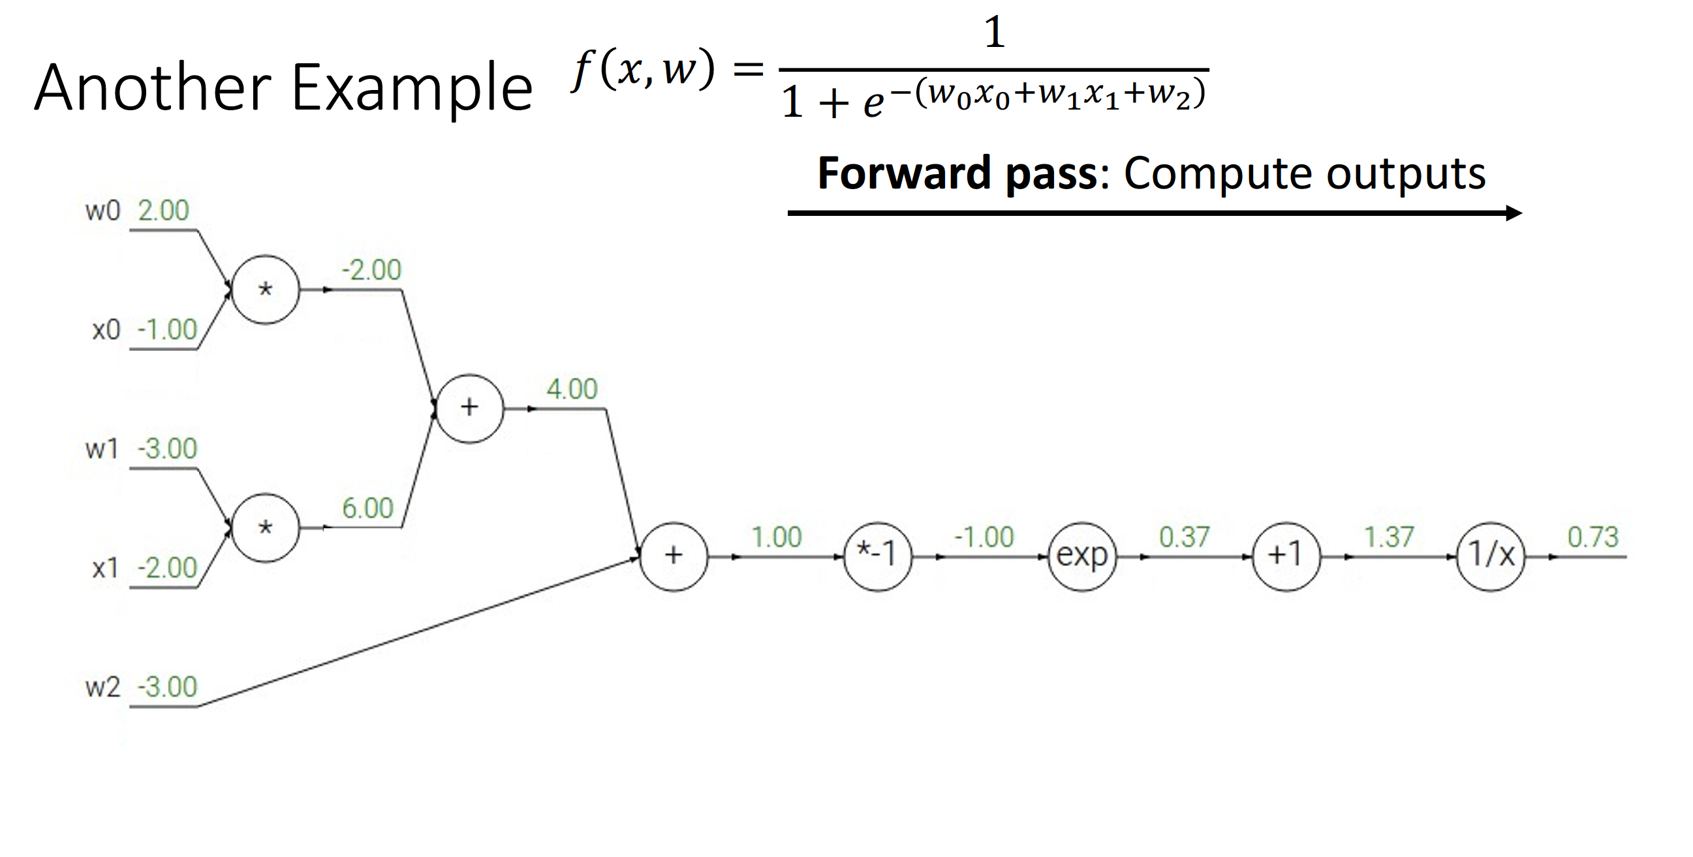

Slide 32
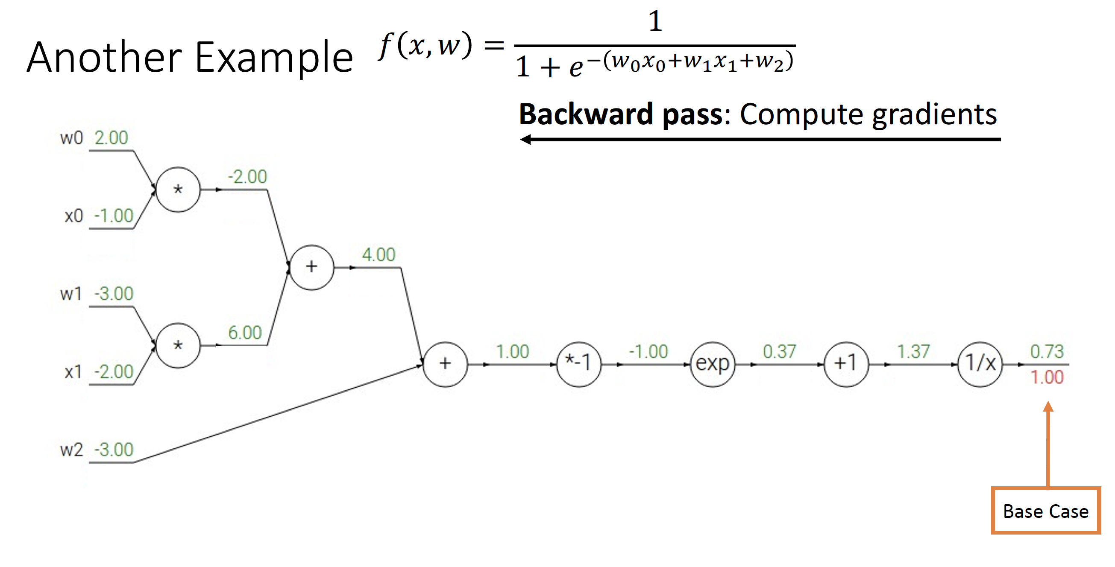

Slide 33
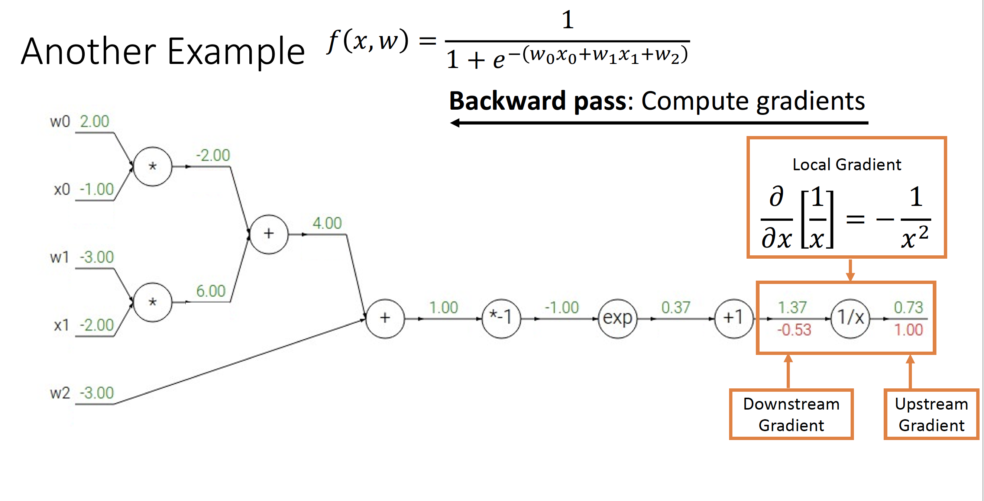
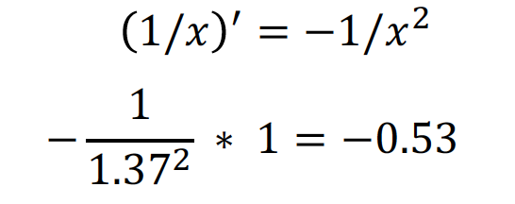

Slide 34
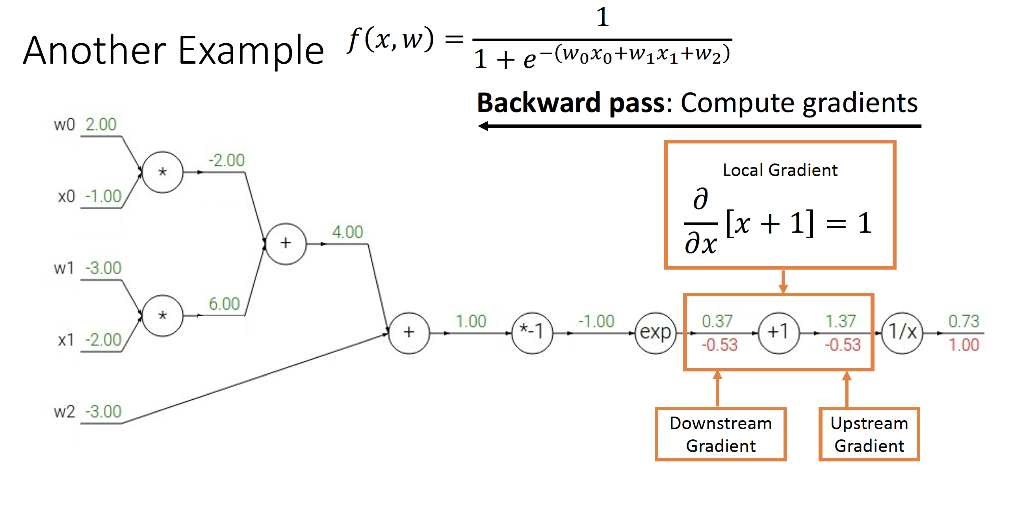

Slide 35
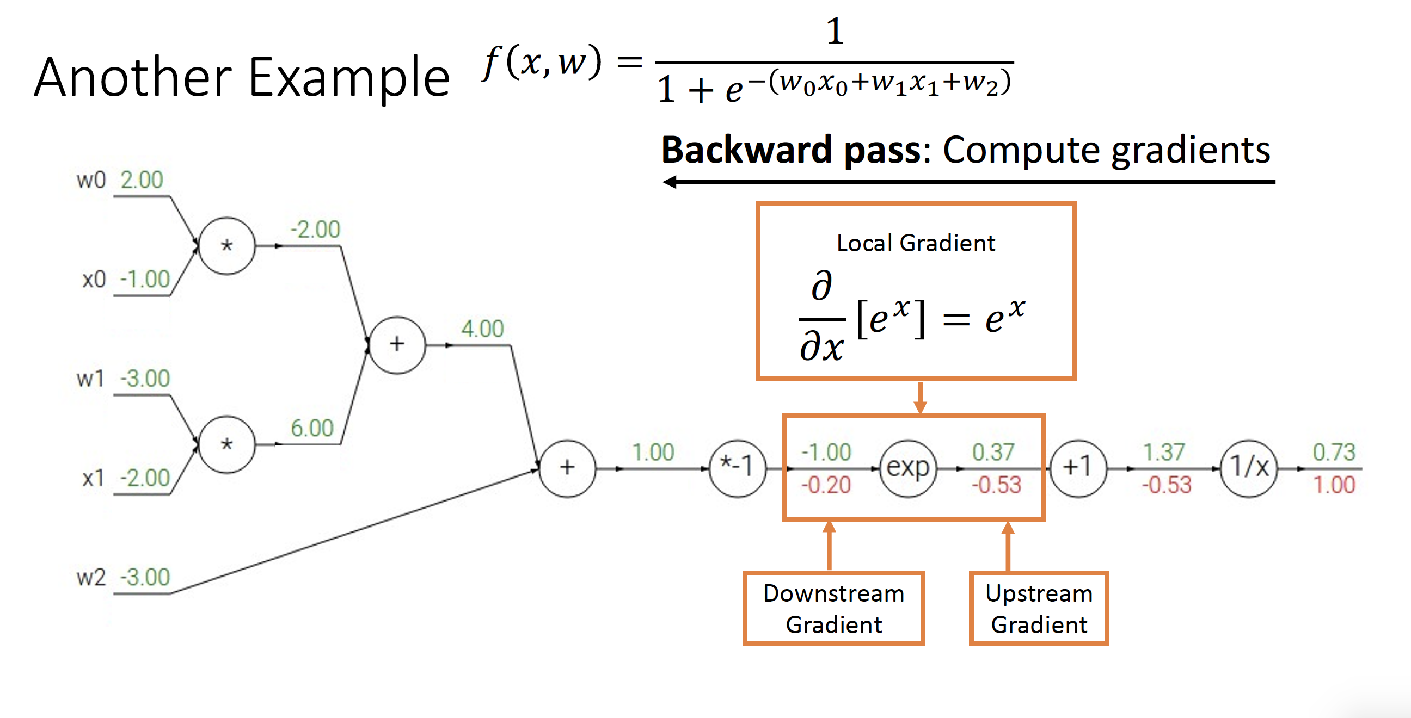
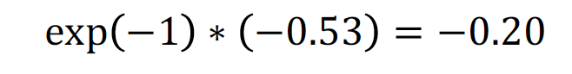

Slide 36
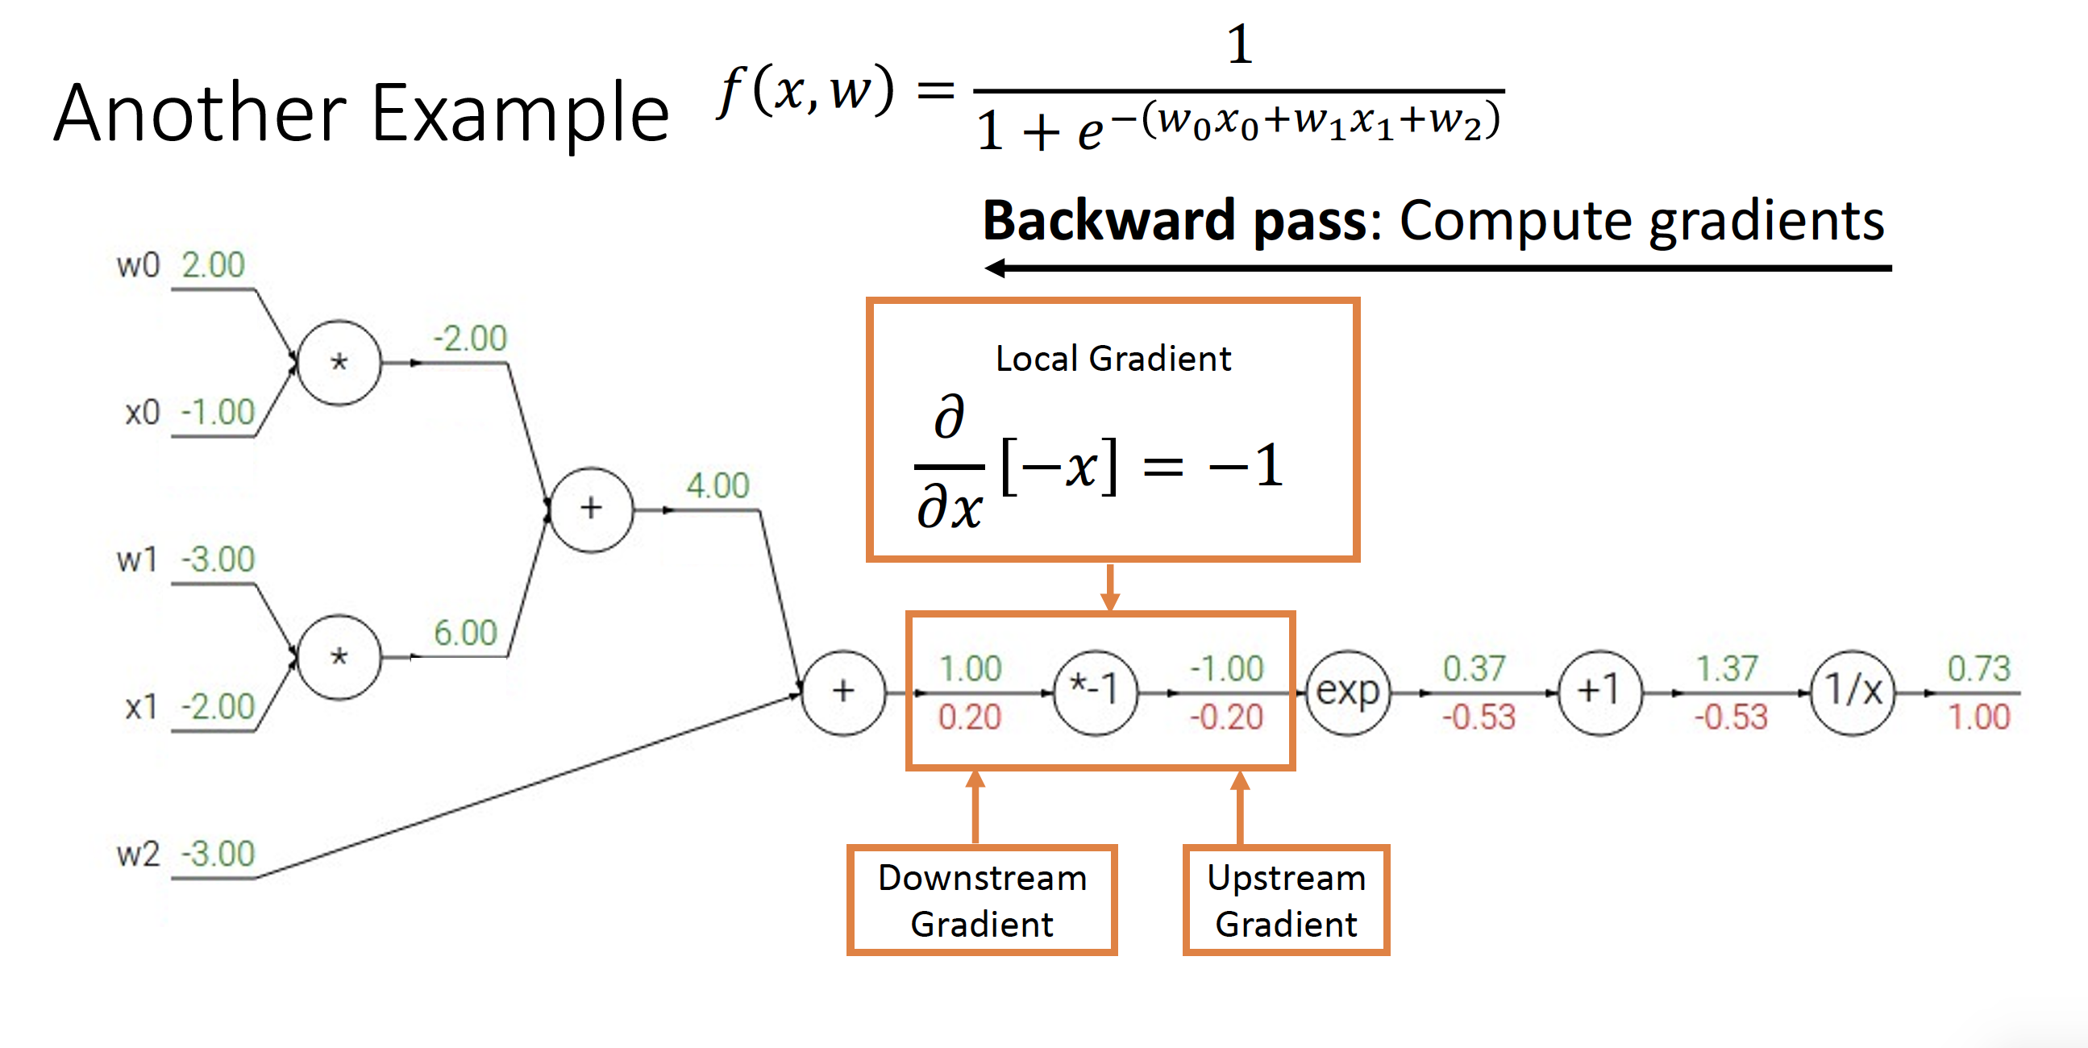

Slide 37
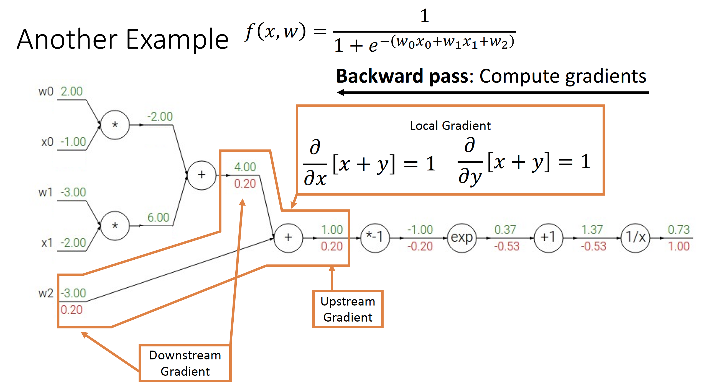

Slide 38
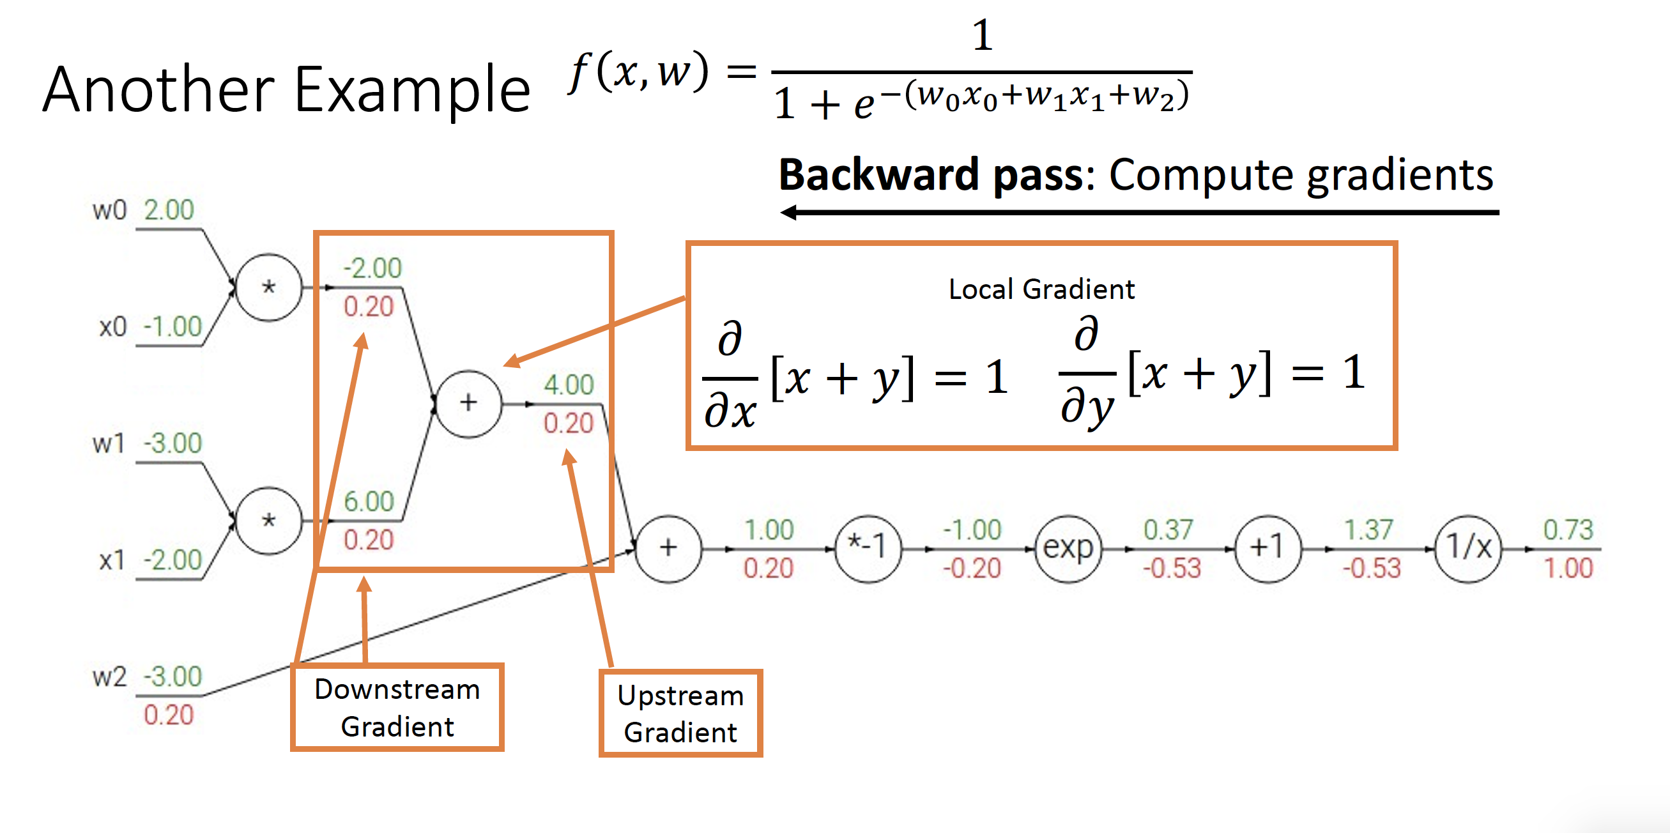

Slide 39
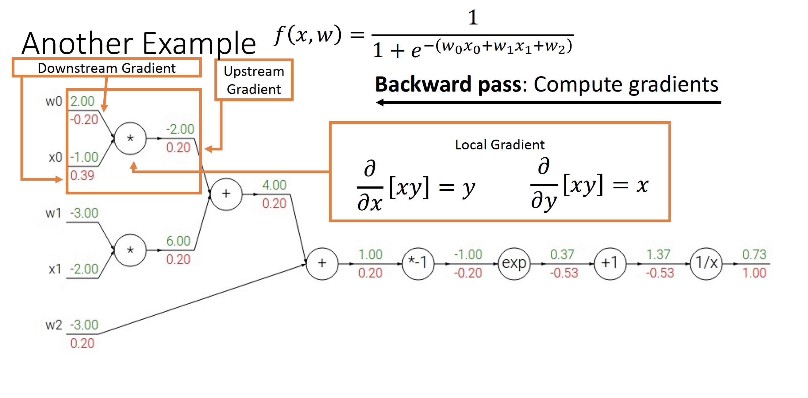
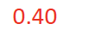

Slide 40
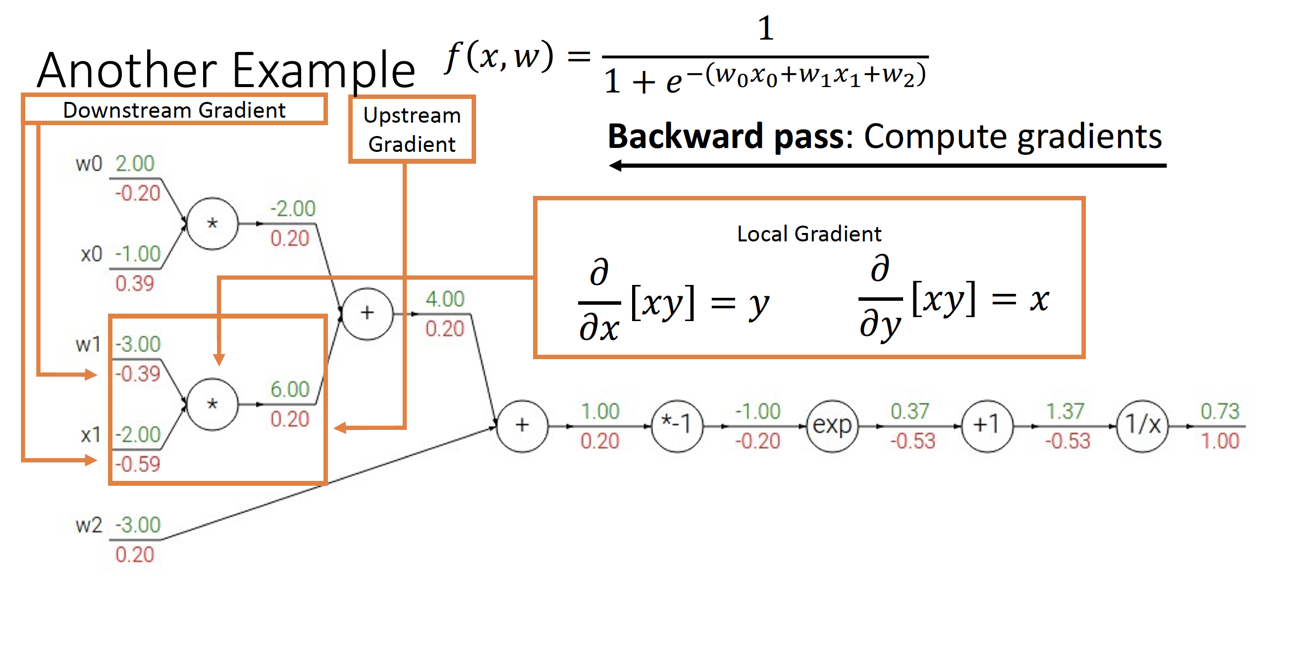
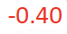
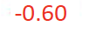

Slide 41
Patterns in Gradient Flow
add gate: gradient distributor 3
2
4
2
7
2
+

Slide 42
Patterns in Gradient Flow
mul gate: “swap multiplier” 2
5*3=15
3
2*5=10
6
5
×

Slide 43
Patterns in Gradient Flow
max gate: gradient router 4
0
5
9
5
9
max

Slide 44
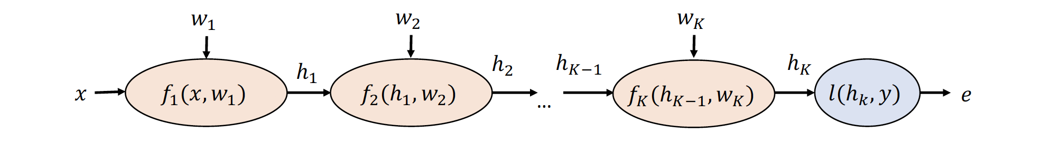
Backward Propagation in Deep Neural Network

Slide 45
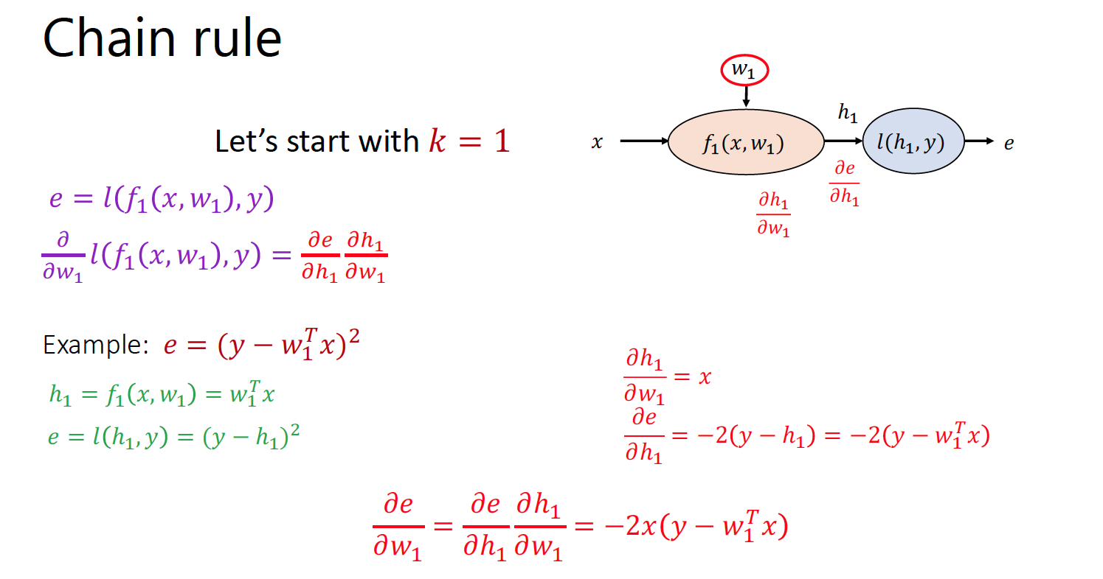

Slide 46
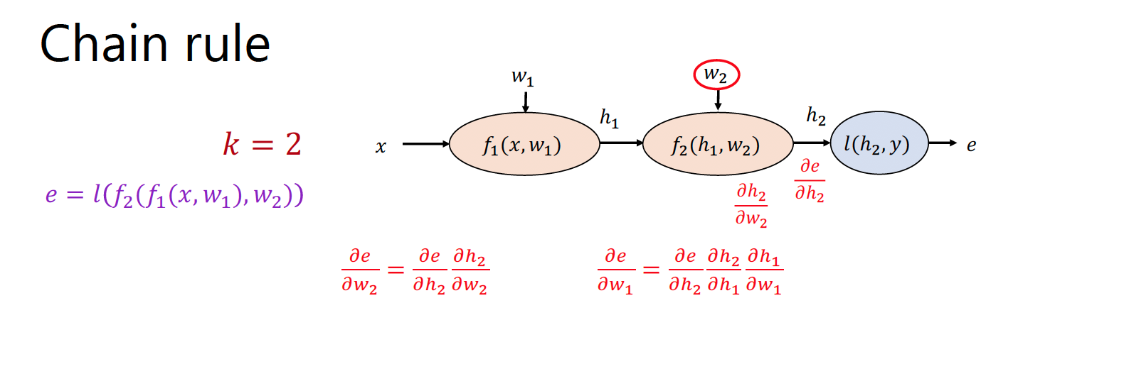

Slide 47
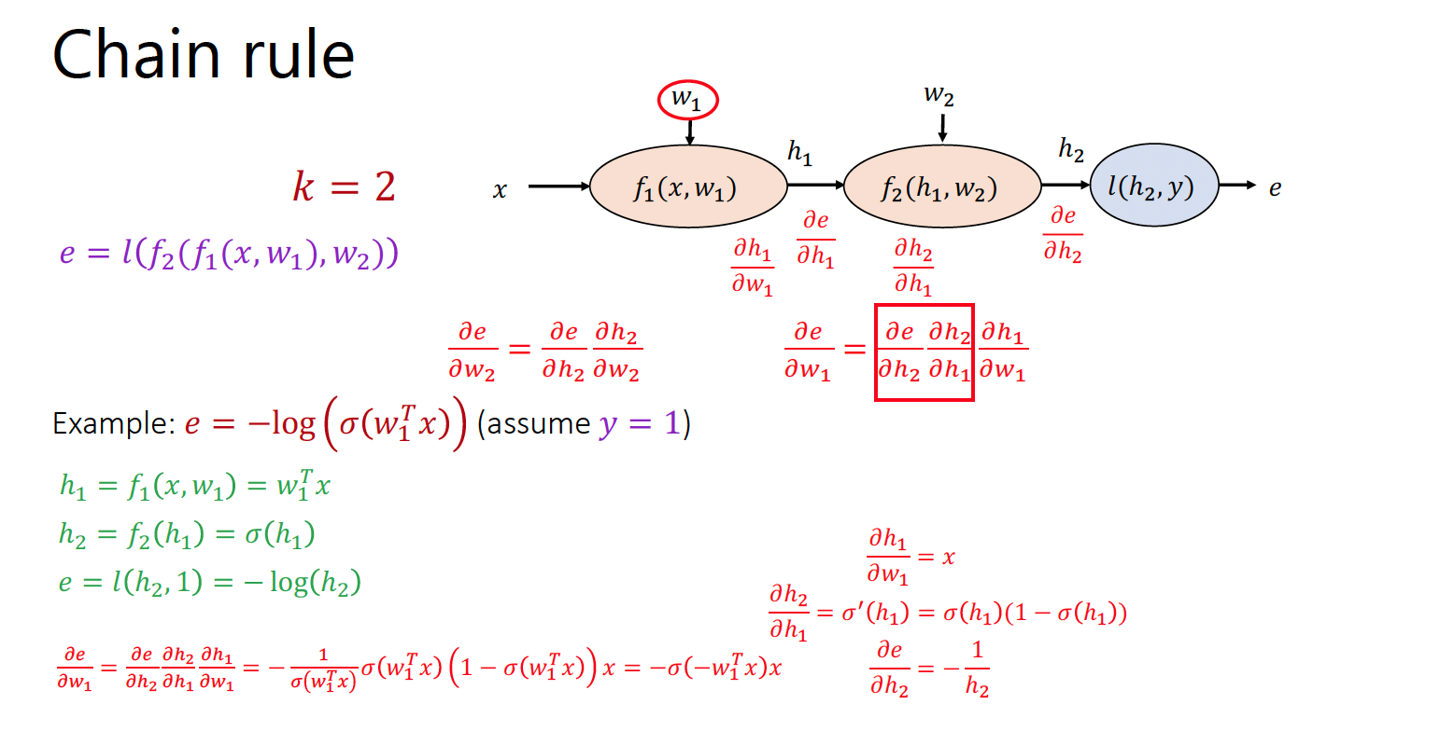

Slide 48
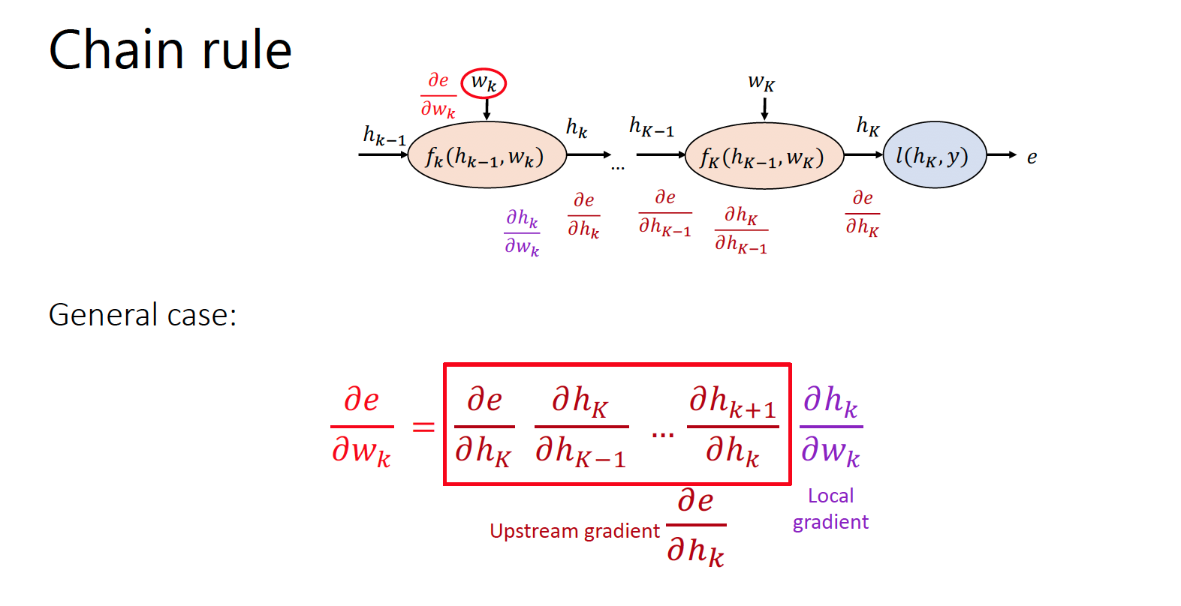

Slide 49
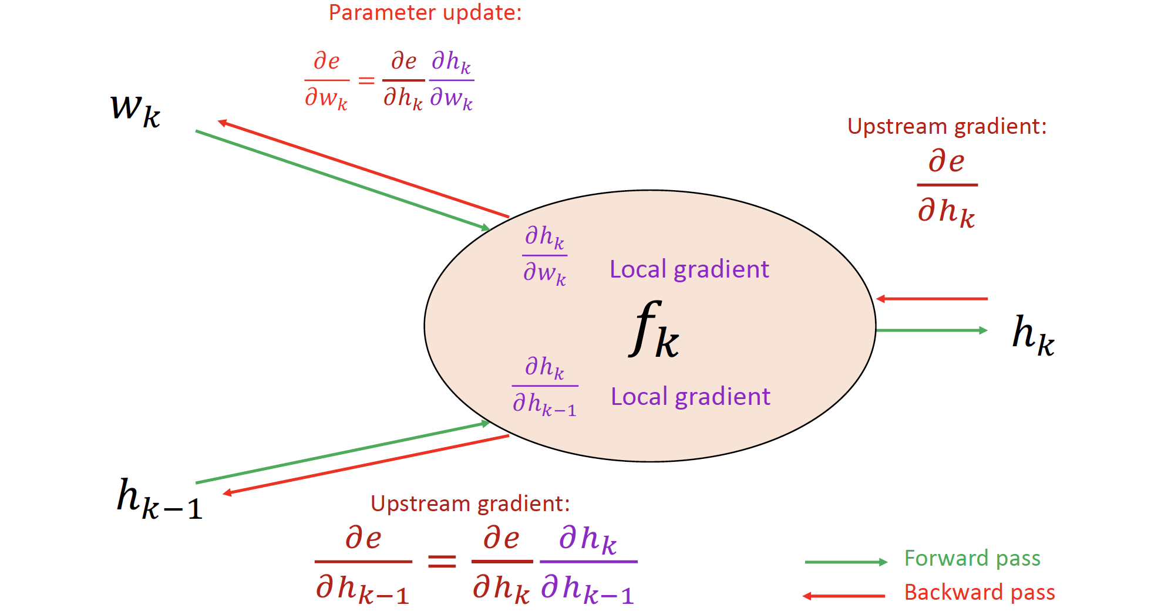
Backward Propagation in Deep Neural Network

Slide 50
Any Question ?

